Slide 1
Security Issues in Public Safety Communication
Kevin Kuo

Slide 2
Agenda
Background
Current State
Near Term State
Objective
Proposed Solution
Overview
Radio Access Network
Device
Application

Slide 3
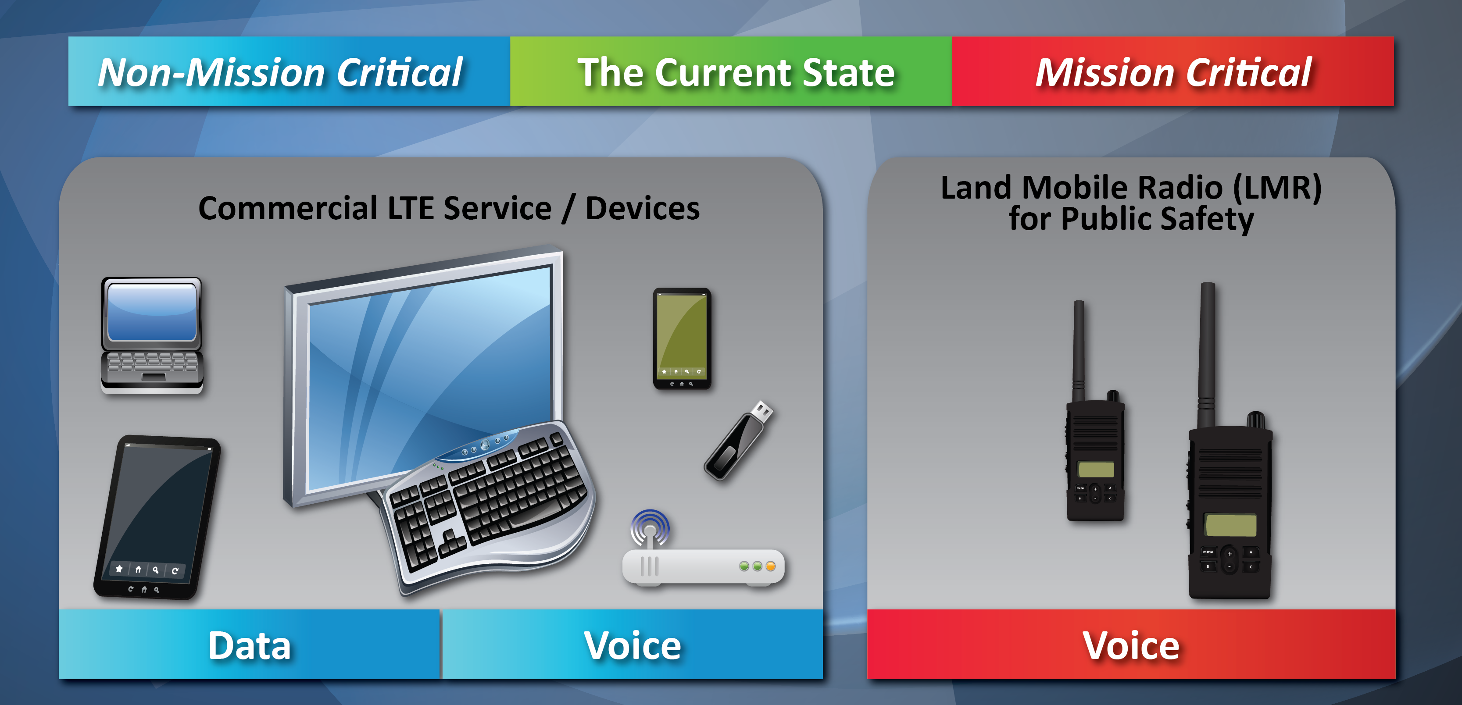
Background – Current State
Notes:
First responders recognized the necessity for public safety communication networks to evolve beyond mission-critical voice services to encompass providing mission critical data services.
Middle Class Tax Relief and Job Creation Act (MCTRJC) of 2012 required FirstNet, a government managed next generation public safety communication network initiative known as the First Responder Network Authority, to build, operate, and maintain the first high speed nationwide broadband network dedicated to public safety.
Demo - equipment

Slide 4
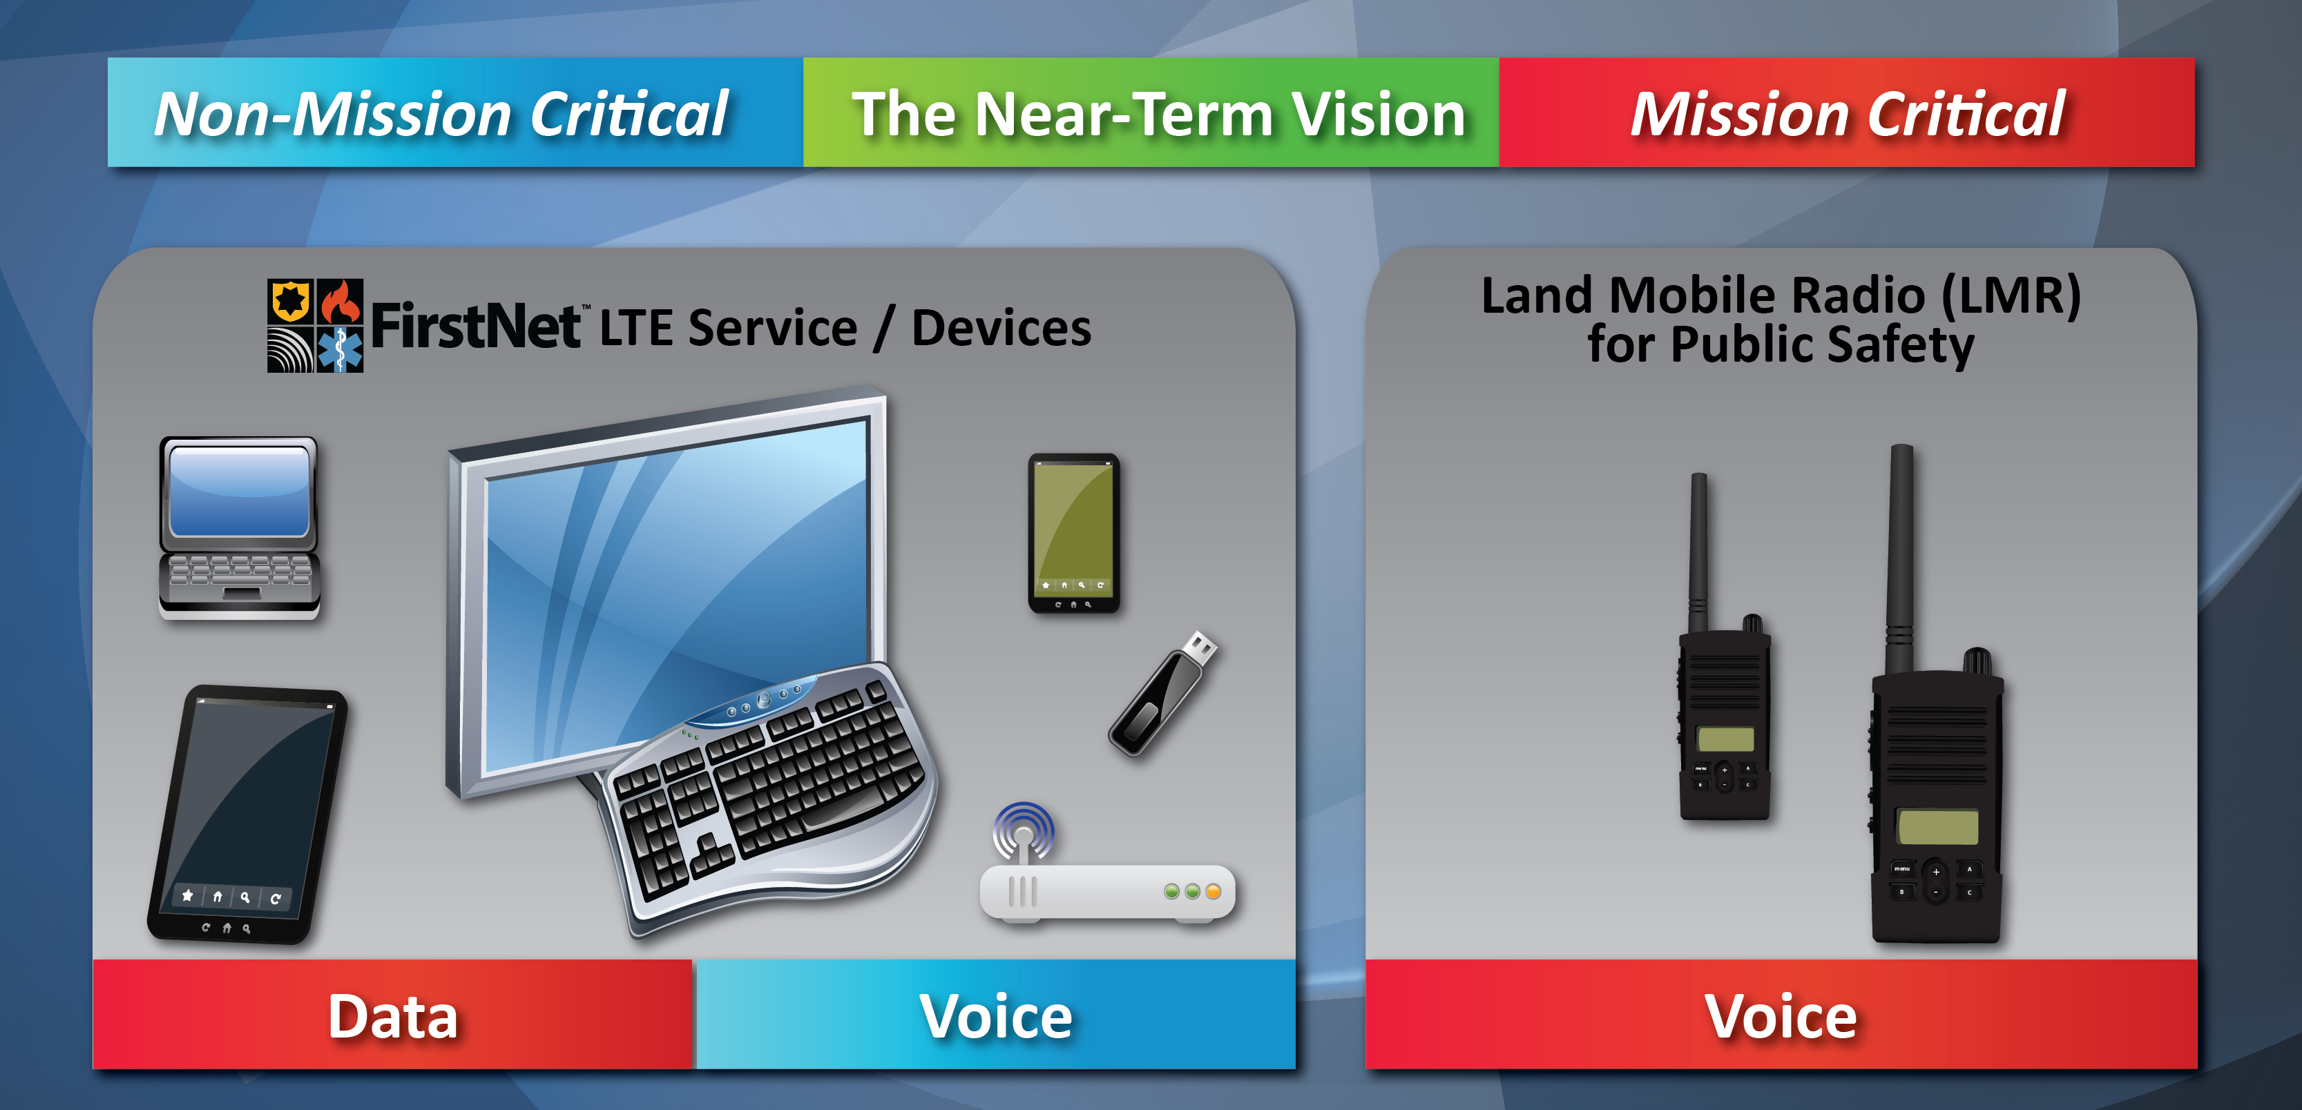
Background – Near Term State
Notes:
Objective of the network will be to provide mission critical, high speed data and video services that will supplement Land Mobile Radio networks which would provide mission critical voice services.

Slide 5
Objective
Propose ways in which FirstNet can protect and secure mission critical data that traverses its network.

Slide 6
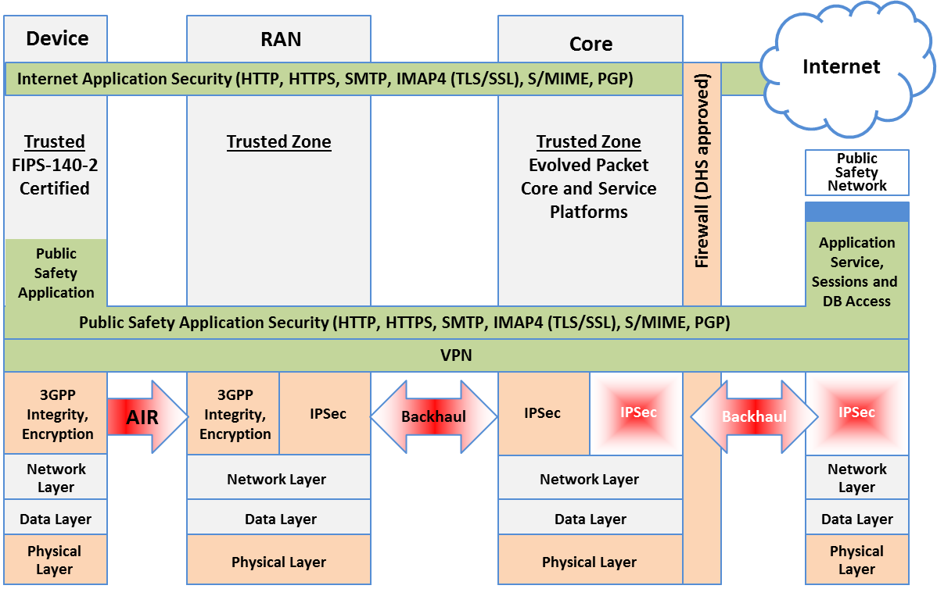
Proposed Solution - Overview

Slide 7
Proposed Solution – Radio Access Network

Slide 8
Proposed Solution – Device

Slide 9
Proposed Solution – Application

Slide 10
Conclusion

Slide 11
Questions?

